Slide 1
Architecture of Enterprise Applications 13 MySQL Backup & Recovery
Haopeng Chen
REliable, INtelligent and Scalable Systems Group (REINS)
Shanghai Jiao Tong University
Shanghai, China
http://reins.se.sjtu.edu.cn/~chenhp
e-mail: chen-hp@sjtu.edu.cn

Slide 2

Contents and Objectives
Contents
Backup and Recovery Types
Database Backup Methods
Example Backup and Recovery Strategy
Using mysqldump for Backups
Point-in-Time (Incremental) Recovery
From: https://dev.mysql.com/doc/refman/8.0/en/backup-and-recovery.html
Objectives
能够根据数据访问的具体场景，设计提高数据库访问性能和灾备能力的方案，包括集群部署和备份机制

Slide 3
Backup and Recovery
It is important to back up your databases
so that you can recover your data and be up and running again in case problems occur, such as system crashes, hardware failures, or users deleting data by mistake.
Backups are also essential as a safeguard before upgrading a MySQL installation, and they can be used to transfer a MySQL installation to another system or to set up replica servers.
Several backup and recovery topics with which you should be familiar:
Types of backups: Logical versus physical, full versus incremental, and so forth.
Methods for creating backups.
Recovery methods, including point-in-time recovery.
Backup scheduling, compression, and encryption.
Table maintenance, to enable recovery of corrupt tables.

Slide 4
Backup and Recovery Types
Physical (Raw) Versus Logical Backups
Physical backups consist of raw copies of the directories and files that store database contents.
This type of backup is suitable for large, important databases that need to be recovered quickly when problems occur.
Logical backups save information represented as logical database structure (CREATE DATABASE, CREATE TABLE statements) and content (INSERT statements or delimited-text files).
This type of backup is suitable for smaller amounts of data where you might edit the data values or table structure, or recreate the data on a different machine architecture.

Slide 5
Backup and Recovery Types
Online Versus Offline Backups
Online backups take place while the MySQL server is running so that the database information can be obtained from the server.
Offline backups take place while the server is stopped.
This distinction can also be described as “hot” versus “cold” backups;
a “warm” backup is one where the server remains running but locked against modifying data while you access database files externally.
Online backup methods have these characteristics:
The backup is less intrusive to other clients, which can connect to the MySQL server during the backup and may be able to access data depending on what operations they need to perform.
Care must be taken to impose appropriate locking so that data modifications do not take place that would compromise backup integrity. The MySQL Enterprise Backup product does such locking automatically.

Slide 6
Backup and Recovery Types
Online Versus Offline Backups
Offline backup methods have these characteristics:
Clients can be affected adversely because the server is unavailable during backup. For that reason, such backups are often taken from a replica that can be taken offline without harming availability.
The backup procedure is simpler because there is no possibility of interference from client activity.
A similar distinction between online and offline applies for recovery operations, and similar characteristics apply.
However, it is more likely for clients to be affected by online recovery than by online backup because recovery requires stronger locking.
During backup, clients might be able to read data while it is being backed up. Recovery modifies data and does not just read it, so clients must be prevented from accessing data while it is being restored.

Slide 7
Backup and Recovery Types
Local Versus Remote Backups
A local backup is performed on the same host where the MySQL server runs,
whereas a remote backup is done from a different host. For some types of backups, the backup can be initiated from a remote host even if the output is written locally on the server host.
mysqldump can connect to local or remote servers.
For SQL output (CREATE and INSERT statements), local or remote dumps can be done and generate output on the client.
For delimited-text output (with the --tab option), data files are created on the server host.
SELECT ... INTO OUTFILE can be initiated from a local or remote client host, but the output file is created on the server host.
Physical backup methods typically are initiated locally on the MySQL server host so that the server can be taken offline, although the destination for copied files might be remote.

Slide 8
Backup and Recovery Types
Snapshot Backups
Some file system implementations enable “snapshots” to be taken.
These provide logical copies of the file system at a given point in time, without requiring a physical copy of the entire file system.
(For example, the implementation may use copy-on-write techniques so that only parts of the file system modified after the snapshot time need be copied.)
MySQL itself does not provide the capability for taking file system snapshots.
It is available through third-party solutions such as Veritas, LVM, or ZFS.

Slide 9
Backup and Recovery Types
Full Versus Incremental Backups
A full backup includes all data managed by a MySQL server at a given point in time.
An incremental backup consists of the changes made to the data during a given time span (from one point in time to another).
MySQL has different ways to perform full backups.
Incremental backups are made possible by enabling the server's binary log, which the server uses to record data changes.

Slide 10
Backup and Recovery Types
Backup Scheduling, Compression, and Encryption
Backup scheduling is valuable for automating backup procedures.
Compression of backup output reduces space requirements, and
encryption of the output provides better security against unauthorized access of backed-up data.
MySQL itself does not provide these capabilities.
The MySQL Enterprise Backup product can compress InnoDB backups, and compression or encryption of backup output can be achieved using file system utilities. Other third-party solutions may be available.

Slide 11
Database Backup Methods
Making a Hot Backup with MySQL Enterprise Backup
Customers of MySQL Enterprise Edition can use the MySQL Enterprise Backup product to do physical backups of entire instances or selected databases, tables, or both.
This product includes features for incremental and compressed backups.
Backing up the physical database files makes restore much faster than logical techniques such as the mysqldump command.
InnoDB tables are copied using a hot backup mechanism.
(Ideally, the InnoDB tables should represent a substantial majority of the data.)
Tables from other storage engines are copied using a warm backup mechanism.

Slide 12
Database Backup Methods
Making Backups with mysqldump
The mysqldump program can make backups. It can back up all kinds of tables.
For InnoDB tables, it is possible to perform an online backup that takes no locks on tables using the --single-transaction option to mysqldump.
Making Backups by Copying Table Files
MyISAM tables can be backed up by copying table files (*.MYD, *.MYI files, and associated *.sdi files). To get a consistent backup, stop the server or lock and flush the relevant tables:
FLUSH TABLES tbl_list WITH READ LOCK;
You need only a read lock; this enables other clients to continue to query the tables while you are making a copy of the files in the database directory.
The flush is needed to ensure that the all active index pages are written to disk before you start the backup.
You can also create a binary backup simply by copying the table files, as long as the server isn't updating anything.
(But note that table file copying methods do not work if your database contains InnoDB tables. Also, even if the server is not actively updating data, InnoDB may still have modified data cached in memory and not flushed to disk.)

Slide 13
Database Backup Methods
Making Delimited-Text File Backups
To create a text file containing a table's data, you can use SELECT * INTO OUTFILE 'file_name' FROM tbl_name.
The file is created on the MySQL server host, not the client host. For this statement, the output file cannot already exist because permitting files to be overwritten constitutes a security risk.
This method works for any kind of data file, but saves only table data, not the table structure.
Another way to create text data files (along with files containing CREATE TABLE statements for the backed up tables) is to use mysqldump with the --tab option.
To reload a delimited-text data file, use LOAD DATA or mysqlimport.

Slide 14
Database Backup Methods
Making Incremental Backups by Enabling the Binary Log
MySQL supports incremental backups using the binary log.
The binary log files provide you with the information you need to replicate changes to the database that are made subsequent to the point at which you performed a backup.
At the moment you want to make an incremental backup (containing all changes that happened since the last full or incremental backup), you should rotate the binary log by using FLUSH LOGS.
The next time you do a full backup, you should also rotate the binary log using FLUSH LOGS or mysqldump --flush-logs.

Slide 15
Database Backup Methods
Making Backups Using Replicas
If you have performance problems with a server while making backups, one strategy that can help is to set up replication and perform backups on the replica rather than on the source.
If you are backing up a replica, you should back up its connection metadata repository and applier metadata repository when you back up the replica's databases, regardless of the backup method you choose.
This information is always needed to resume replication after you restore the replica's data.
If your replica is replicating LOAD DATA statements, you should also back up any SQL_LOAD-* files that exist in the directory that the replica uses for this purpose.
The replica needs these files to resume replication of any interrupted LOAD DATA operations.

Slide 16
Database Backup Methods
Recovering Corrupt Tables
If you have to restore MyISAM tables that have become corrupt, try to recover them using REPAIR TABLE or myisamchk -r first. That should work in 99.9% of all cases.
Making Backups Using a File System Snapshot
If you are using a Veritas file system, you can make a backup like this:
From a client program, execute FLUSH TABLES WITH READ LOCK.
From another shell, execute mount vxfs snapshot.
From the first client, execute UNLOCK TABLES.
Copy files from the snapshot.
Unmount the snapshot.
Similar snapshot capabilities may be available in other file systems, such as LVM or ZFS.

Slide 17
Example Backup and Recovery Strategy
Let’s discuss a procedure for performing backups that enables you to recover data after several types of crashes:
Operating system crash
Power failure
File system crash
Hardware problem (hard drive, motherboard, and so forth)
Assume that data is stored in the InnoDB storage engine, which has support for transactions and automatic crash recovery.
Assume also that the MySQL server is under load at the time of the crash. If it were not, no recovery would ever be needed.

Slide 18
Example Backup and Recovery Strategy
For cases of operating system crashes or power failures, we can assume that MySQL's disk data is available after a restart.
The InnoDB data files might not contain consistent data due to the crash, but InnoDB reads its logs and finds in them the list of pending committed and noncommitted transactions that have not been flushed to the data files.
InnoDB automatically rolls back those transactions that were not committed, and flushes to its data files those that were committed.

Slide 19
Example Backup and Recovery Strategy
For the cases of file system crashes or hardware problems, we can assume that the MySQL disk data is not available after a restart.
This means that MySQL fails to start successfully because some blocks of disk data are no longer readable.
In this case, it is necessary to reformat the disk, install a new one, or otherwise correct the underlying problem.
Then it is necessary to recover our MySQL data from backups, which means that backups must already have been made. To make sure that is the case, design and implement a backup policy.

Slide 20
Example Backup and Recovery Strategy
Establishing a Backup Policy
To be useful, backups must be scheduled regularly.
Assume that we make a full backup of all our InnoDB tables in all databases using the following command on Sunday at 1 p.m., when load is low:
shell> mysqldump --all-databases --master-data --single-transaction > backup_sunday_1_PM.sql
The resulting .sql file produced by mysqldump contains a set of SQL INSERT statements that can be used to reload the dumped tables at a later time.
This backup operation acquires a global read lock on all tables at the beginning of the dump.
Full backups are necessary, but it is not always convenient to create them.

Slide 21
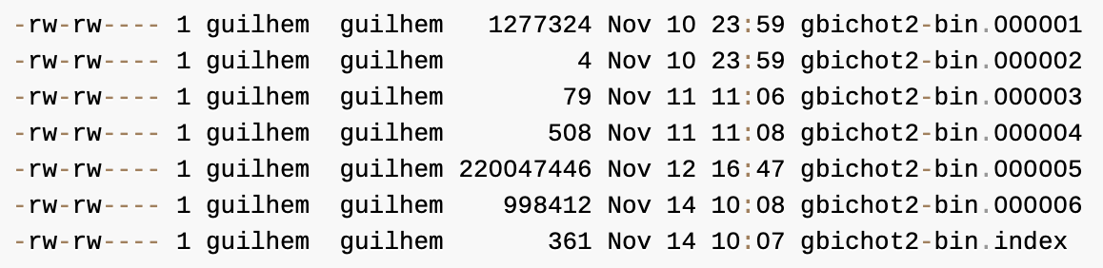
Example Backup and Recovery Strategy
Establishing a Backup Policy
To make incremental backups, we need to save the incremental changes.
In MySQL, these changes are represented in the binary log,
so the MySQL server should always be started with the --log-bin option to enable that log. With binary logging enabled, the server writes each data change into a file while it updates data.
The MySQL binary logs take up disk space. To free up space, purge them from time to time:
shell> mysqldump --single-transaction --flush-logs --master-data=2 \
--all-databases --delete-master-logs > backup_sunday_1_PM.sql

Slide 22
Example Backup and Recovery Strategy
Using Backups for Recovery
Now, suppose that we have a catastrophic unexpected exit on Wednesday at 8 a.m. that requires recovery from backups.
To recover, first we restore the last full backup we have (the one from Sunday 1 p.m.):
shell> mysql < backup_sunday_1_PM.sql
At this point, the data is restored to its state as of Sunday 1 p.m.
To restore the changes made since then, we must use the incremental backups; that is, the gbichot2-bin.000007 and gbichot2-bin.000008 binary log files.
Fetch the files if necessary from where they were backed up, and then process their contents like this:
shell> mysqlbinlog gbichot2-bin.000007 gbichot2-bin.000008 | mysql

Slide 23
Example Backup and Recovery Strategy
Using Backups for Recovery
We now have recovered the data to its state as of Tuesday 1 p.m., but still are missing the changes from that date to the date of the crash.
To not lose them, we would have needed to have the MySQL server store its MySQL binary logs into a safe location (RAID disks, SAN, ...) different from the place where it stores its data files, so that these logs were not on the destroyed disk.
(That is, we can start the server with a --log-bin option that specifies a location on a different physical device from the one on which the data directory resides.)
If we had done this, we would have the gbichot2-bin.000009 file (and any subsequent files) at hand, and we could apply them using mysqlbinlog and mysql to restore the most recent data changes with no loss up to the moment of the crash:
shell> mysqlbinlog gbichot2-bin.000009 ... | mysql

Slide 24
Example Backup and Recovery Strategy
Backup Strategy Summary
In case of an operating system crash or power failure, InnoDB itself does all the job of recovering data. But to make sure that you can sleep well, observe the following guidelines:
Always run the MySQL server with binary logging enabled (that is the default setting for MySQL 8.0).
If you have such safe media, this technique can also be good for disk load balancing (which results in a performance improvement).
Make periodic full backups, using the mysqldump command that makes an online, nonblocking backup.
Make periodic incremental backups by flushing the logs with FLUSH LOGS or mysqladmin flush-logs.

Slide 25
Using mysqldump for Backups
Consider using the MySQL Shell dump utilities, which provide
parallel dumping with multiple threads, file compression, and progress information display, as well as cloud features such as Oracle Cloud Infrastructure Object Storage streaming, and MySQL Database Service compatibility checks and modifications.
Dumps can be easily imported into a MySQL Server instance or a MySQL Database Service DB System using the MySQL Shell load dump utilities.
A dump file can be used in several ways:
As a backup to enable data recovery in case of data loss.
As a source of data for setting up replicas.
As a source of data for experimentation:
To make a copy of a database that you can use without changing the original data.
To test potential upgrade incompatibilities.

Slide 26
Using mysqldump for Backups
mysqldump produces two types of output, depending on whether the --tab option is given:
Without --tab, mysqldump writes SQL statements to the standard output.
This output consists of CREATE statements to create dumped objects (databases, tables, stored routines, and so forth), and INSERT statements to load data into tables.
The output can be saved in a file and reloaded later using mysql to recreate the dumped objects. Options are available to modify the format of the SQL statements, and to control which objects are dumped.
With --tab, mysqldump produces two output files for each dumped table.
The server writes one file as tab-delimited text, one line per table row. This file is named tbl_name.txt in the output directory.
The server also sends a CREATE TABLE statement for the table to mysqldump, which writes it as a file named tbl_name.sql in the output directory.

Slide 27
Using mysqldump for Backups
Dumping Data in SQL Format with mysqldump
By default, mysqldump writes information as SQL statements to the standard output. You can save the output in a file:
shell> mysqldump [arguments] > file_name
To dump all databases, invoke mysqldump with the --all-databases option:
shell> mysqldump --all-databases > dump.sql
To dump only specific databases, name them on the command line and use the --databases option:
shell> mysqldump --databases db1 db2 db3 > dump.sql
To dump a single database, name it on the command line:
shell> mysqldump --databases test > dump.sql
In the single-database case, it is permissible to omit the --databases option:
shell> mysqldump test > dump.sql
To dump only specific tables from a database, name them on the command line following the database name:
shell> mysqldump test t1 t3 t7 > dump.sql

Slide 28
Using mysqldump for Backups
Reloading SQL-Format Backups
If the dump file was created by mysqldump with the --all-databases or --databases option, it contains CREATE DATABASE and USE statements and it is not necessary to specify a default database into which to load the data:
shell> mysql < dump.sql
Alternatively, from within mysql, use a source command:
mysql> source dump.sql
If the file is a single-database dump not containing CREATE DATABASE and USE statements, create the database first (if necessary):
shell> mysqladmin create db1
Then specify the database name when you load the dump file:
shell> mysql db1 < dump.sql
Alternatively, from within mysql, create the database, select it as the default database, and load the dump file:
mysql> CREATE DATABASE IF NOT EXISTS db1;
mysql> USE db1;
mysql> source dump.sql

Slide 29
Using mysqldump for Backups
Dumping Data in Delimited-Text Format with mysqldump
If you invoke mysqldump with the --tab=dir_name option, it uses dir_name as the output directory and dumps tables individually in that directory using two files for each table. The table name is the base name for these files.
For a table named t1, the files are named t1.sql and t1.txt. The .sql file contains a CREATE TABLE statement for the table. The .txt file contains the table data, one line per table row.
The following command dumps the contents of the db1 database to files in the /tmp database:
shell> mysqldump --tab=/tmp db1

Slide 30
Using mysqldump for Backups
Reloading Delimited-Text Format Backups
To reload a table, first change location into the output directory. Then process the .sql file with mysql to create an empty table and process the .txt file to load the data into the table:
shell> mysql db1 < t1.sql
shell> mysqlimport db1 t1.txt
An alternative to using mysqlimport to load the data file is to use the LOAD DATA statement from within the mysql client:
mysql> USE db1;
mysql> LOAD DATA INFILE 't1.txt' INTO TABLE t1;
If you used any data-formatting options with mysqldump when you initially dumped the table, you must use the same options with mysqlimport or LOAD DATA to ensure proper interpretation of the data file contents:
shell> mysqlimport --fields-terminated-by=, --fields-enclosed-by='"' --lines-terminated-by=0x0d0a db1 t1.txt
Or:
mysql> USE db1;
mysql> LOAD DATA INFILE 't1.txt' INTO TABLE t1 FIELDS TERMINATED BY ',' FIELDS ENCLOSED BY '"' LINES TERMINATED BY '\r\n';

Slide 31
mysqldump Tips
How to make a copy of a database
How to copy a database from one server to another
How to dump stored programs (stored procedures and functions, triggers, and events)
How to dump definitions and data separately

Slide 32
mysqldump Tips
Making a Copy of a Database
shell> mysqldump db1 > dump.sql
shell> mysqladmin create db2
shell> mysql db2 < dump.sql
Do not use --databases on the mysqldump command line because that causes USE db1 to be included in the dump file, which overrides the effect of naming db2 on the mysql command line.

Slide 33
mysqldump Tips
Copy a Database from one Server to Another
On Server 1:
shell> mysqldump --databases db1 > dump.sql
Copy the dump file from Server 1 to Server 2.
On Server 2:
shell> mysql < dump.sql
Alternatively, you can omit --databases from the mysqldump command.
On Server 1:
shell> mysqldump db1 > dump.sql
On Server 2:
shell> mysqladmin create db1
shell> mysql db1 < dump.sql

Slide 34
mysqldump Tips
Dumping Stored Programs
Several options control how mysqldump handles stored programs (stored procedures and functions, triggers, and events):
--events: Dump Event Scheduler events
--routines: Dump stored procedures and functions
--triggers: Dump triggers for tables
The --triggers option is enabled by default so that when tables are dumped, they are accompanied by any triggers they have.
The other options are disabled by default and must be specified explicitly to dump the corresponding objects.
To disable any of these options explicitly, use its skip form: --skip-events, --skip-routines, or --skip-triggers.

Slide 35
mysqldump Tips
Dumping Table Definitions and Content Separately
The --no-data option tells mysqldump not to dump table data, resulting in the dump file containing only statements to create the tables.
Conversely, the --no-create-info option tells mysqldump to suppress CREATE statements from the output, so that the dump file contains only table data.
For example, to dump table definitions and data separately for the test database, use these commands:
shell> mysqldump --no-data test > dump-defs.sql
shell> mysqldump --no-create-info test > dump-data.sql
For a definition-only dump, add the --routines and --events options to also include stored routine and event definitions:
shell> mysqldump --no-data --routines --events test > dump-defs.sql

Slide 36
mysqldump Tips
Using mysqldump to Test for Upgrade Incompatibilities
When contemplating a MySQL upgrade, it is prudent to install the newer version separately from your current production version.
Then you can dump the database and database object definitions from the production server and load them into the new server to verify that they are handled properly. (This is also useful for testing downgrades.)
On the production server:
shell> mysqldump --all-databases --no-data --routines --events > dump-defs.sql
On the upgraded server:
shell> mysql < dump-defs.sql
Because the dump file does not contain table data, it can be processed quickly.

Slide 37
mysqldump Tips
Using mysqldump to Test for Upgrade Incompatibilities
This enables you to spot potential incompatibilities without waiting for lengthy data-loading operations. Look for warnings or errors while the dump file is being processed.
After you have verified that the definitions are handled properly, dump the data and try to load it into the upgraded server.
On the production server:
shell> mysqldump --all-databases --no-create-info > dump-data.sql
On the upgraded server:
shell> mysql < dump-data.sql
Now check the table contents and run some test queries.

Slide 38
Point-in-Time (Incremental) Recovery
Point-in-time recovery refers to
recovery of data changes up to a given point in time.
Typically, this type of recovery is performed after restoring a full backup that brings the server to its state as of the time the backup was made.
Point-in-time recovery then brings the server up to date incrementally from the time of the full backup to a more recent time.

Slide 39
Point-in-Time (Incremental) Recovery
Point-in-Time Recovery Using Binary Log
To restore data from the binary log, you must know the name and location of the current binary log files.
mysql> SHOW BINARY LOGS;
To determine the name of the current binary log file, issue the following statement:
mysql> SHOW MASTER STATUS;
To apply events from the binary log, process mysqlbinlog output using the mysql client:
shell> mysqlbinlog binlog_files | mysql -u root –p
If binary log files have been encrypted, which can be done from MySQL 8.0.14 onwards, mysqlbinlog cannot read them directly as in the above example, but can read them from the server using the --read-from-remote-server (-R) option. For example:
shell> mysqlbinlog --read-from-remote-server --host=host_name --port=3306 --user=root --password --ssl-mode=required binlog_files | mysql -u root -p

Slide 40
Point-in-Time (Incremental) Recovery
Point-in-Time Recovery Using Binary Log
To view events from the log, send mysqlbinlog output into a paging program:
shell> mysqlbinlog binlog_files | more
Alternatively, save the output in a file and view the file in a text editor:
shell> mysqlbinlog binlog_files > tmpfile
shell> ... edit tmpfile ...
Saving the output in a file is useful as a preliminary to executing the log contents with certain events removed, such as an accidental DROP TABLE.
You can delete from the file any statements not to be executed before executing its contents.
After editing the file, apply the contents as follows:
shell> mysql -u root -p < tmpfile

Slide 41
Point-in-Time (Incremental) Recovery
Point-in-Time Recovery Using Binary Log
If you have more than one binary log to apply on the MySQL server, the safe method is to process them all using a single connection to the server.
Here is an example that demonstrates what may be unsafe:
shell> mysqlbinlog binlog.000001 | mysql -u root -p # DANGER!!
shell> mysqlbinlog binlog.000002 | mysql -u root -p # DANGER!!
Processing binary logs this way using different connections to the server causes problems if the first log file contains a CREATE TEMPORARY TABLE statement and the second log contains a statement that uses the temporary table.
When the first mysql process terminates, the server drops the temporary table.
When the second mysql process attempts to use the table, the server reports “unknown table.”

Slide 42
Point-in-Time (Incremental) Recovery
Point-in-Time Recovery Using Binary Log
To avoid problems like this, use a single connection to apply the contents of all binary log files that you want to process.
Here is one way to do so:
shell> mysqlbinlog binlog.000001 binlog.000002 | mysql -u root -p
Another approach is to write the whole log to a single file and then process the file:
shell> mysqlbinlog binlog.000001 > /tmp/statements.sql
shell> mysqlbinlog binlog.000002 >> /tmp/statements.sql
shell> mysql -u root -p -e "source /tmp/statements.sql"
When writing to a dump file while reading back from a binary log containing GTIDs (“Replication with Global Transaction Identifiers”), use the --skip-gtids option with mysqlbinlog, like this:
shell> mysqlbinlog --skip-gtids binlog.000001 > /tmp/dump.sql
shell> mysqlbinlog --skip-gtids binlog.000002 >> /tmp/dump.sql
shell> mysql -u root -p -e "source /tmp/dump.sql"

Slide 43
Point-in-Time (Incremental) Recovery
Point-in-Time Recovery Using Event Positions
As an example, suppose that around 20:06:00 on March 11, 2020, an SQL statement was executed that deleted a table.
You can perform a point-in-time recovery to restore the server up to its state right before the table deletion.
These are some sample steps to achieve that:
Restore the last full backup created before the point-in-time of interest (call it t_{p}, which is 20:06:00 on March 11, 2020 in our example). When finished, note the binary log position up to which you have restored the server for later use, and restart the server.
Find the precise binary log event position corresponding to the point in time up to which you want to restore your database.
In our example, given that we know the rough time where the table deletion took place (t_{p}), we can find the log position by checking the log contents around that time using the mysqlbinlog utility.
Use the --start-datetime and --stop-datetime options to specify a short time period around t_{p}, and then look for the event in the output.

Slide 44
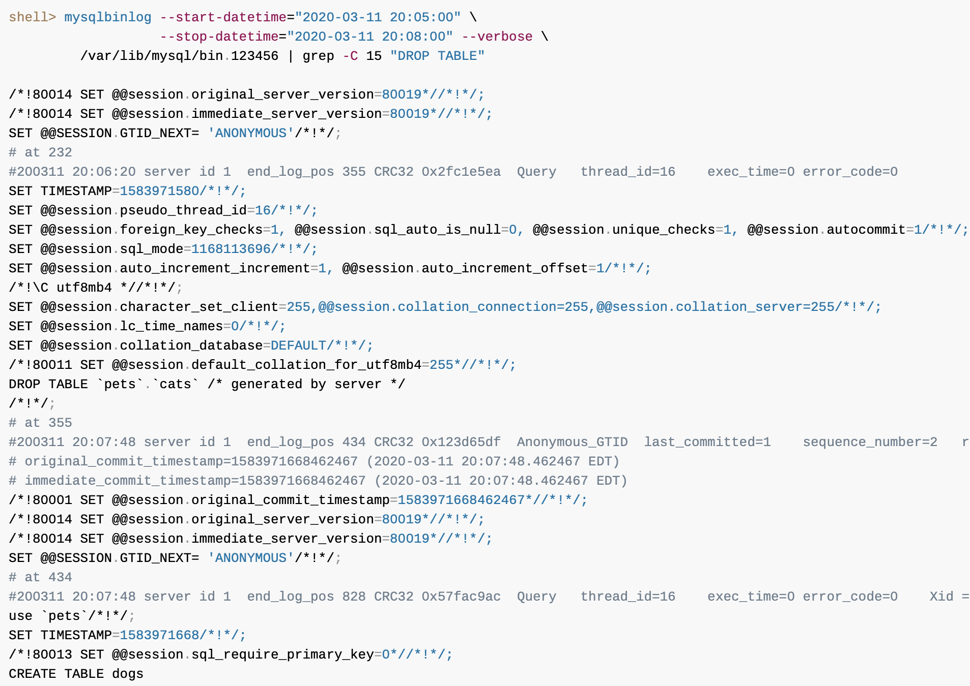
Point-in-Time (Incremental) Recovery
Point-in-Time Recovery Using Event Positions

Slide 45
Point-in-Time (Incremental) Recovery
Point-in-Time Recovery Using Event Positions
Apply the events in binary log file to the server, starting with the log position your found in step 1 (assume it is 155) and ending at the position you have found in step 2 that is before your point-in-time of interest (which is 232):
shell> mysqlbinlog --start-position=155 --stop-position=232 /var/lib/mysql/bin.123456 \ | mysql -u root -p
Your database has now been restored to the point-in-time of interest, t_{p}, right before the table pets.cats was dropped.
Beyond the point-in-time recovery that has been finished, if you also want to reexecute all the statements after your point-in-time of interest, use mysqlbinlog again to apply all the events after t_{p} to the server.
We noted in step 2 that after the statement we wanted to skip, the log is at position 355; we can use it for the --start-position option, so that any statements after the position are included:
shell> mysqlbinlog --start-position=355 /var/lib/mysql/bin.123456 \ | mysql -u root -p

Slide 46

Thank You!

